Slide 1
CSE 3411 System Analysis and Design (SAD)
Dr. Suman Ahmmed

Slide 2
SDLC Steps
Idea Generation (optional)
Planning
System Information/Requirement Gathering
Analysis
Design
Development/Construction/Coding
Testing
Deployment
Post–Implementation & Maintenance

Slide 3
System Design

Slide 4
System Design
Process of defining the architecture, components, modules, interfaces, and data for a system to satisfy specified requirements.
Translating user requirements into a detailed blueprint that guides the implementation phase.
Provides the backbone to handle exceptional scenarios.

Slide 5
Objectives of System Design
Practicality
Accuracy
Completeness
Efficiency
Reliability
Optimization
Scalability

Slide 6
System Design
Specifies the following:
System Requirements
Process Flow / Diagram
Business Rules
Database Design
System Visualization / UI Design
System Architecture (2 Tier, 3 Tier, Cloud, MVC )

Slide 7
System Design
There are various concepts when it comes to designing a system.
They include:
Object-Oriented Designs (e.g. UML)
Structured Designs
Dynamic Systems Designs

Slide 8
Unified Modeling Language (UML)
A general-purpose modeling language
A standard way to visualize the way a system has been designed
Portray the behavior and structure of a system
The Object Management Group (OMG) adopted UML as a standard in 1997. It’s been managed by OMG ever since.
The International Organization for Standardization (ISO) published UML as an approved standard in 2005. UML has been revised over the years and is reviewed periodically.

Slide 9
Why need UML?
Provides a clear and concise way for multiple teams to communicate with each other
Good way to allow non-programmers to understand the requirements and processes
Saves a lot of time if processes are visualized beforehand

Slide 10
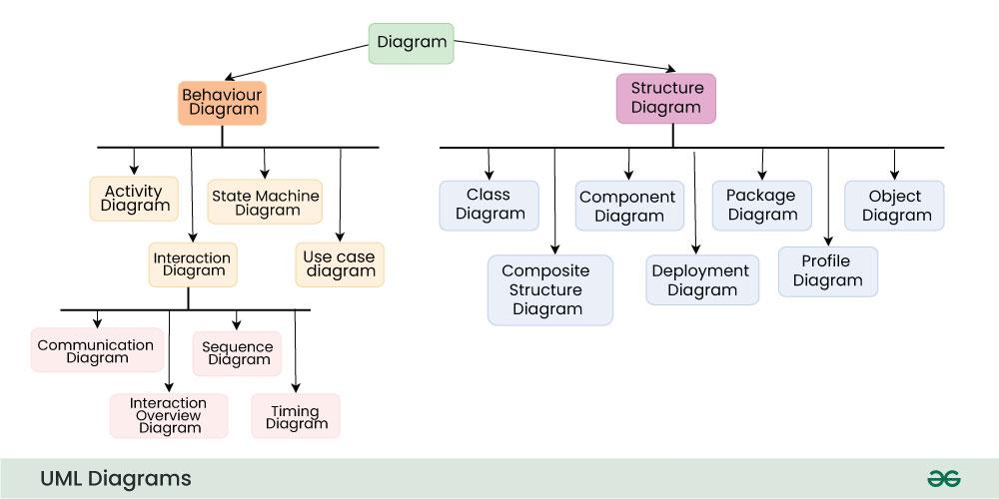
UML Diagrams
As of version 2.5.1, there are 14 UML Diagrams, which are grouped into 2 categories: Structural and Behavioral

Slide 11
Diagrams for this course
Object-Oriented Design Diagrams
Use Case Diagram (UML)
Activity Diagram (UML)
Swimlane Diagram (BPMN)
Class Diagram (UML) [Evolved from CRC)
State Diagram (UML)
Sequence Diagram (UML)
Deployment Diagram (UML)
Structured Design Diagrams
Entity-Relationship Diagram
Context Diagram
Data Flow Diagram

Slide 12
Context Diagram
Bird’s Eye View of a System
Contains only one process (Process 0), that represents the Whole System
System or the Process Zero node is connected with the External Entities (EE) / Stakeholders / Actors ( types of users )
Helps identify the scope of the project early on
Some form of Context Diagram is also known as Data Flow Diagram Level 0

Slide 13
Context Diagram
Steps:
Label the system/process in the centre – name of system/process usually contains a verb
Identify entities that interact directly with the system/process – entities are usually a noun
Group together like entities
Identify major flows of data between the entity and system/process

Slide 14
Context Diagram
Rules:
Systems/Processes are shown in circles; ‘0’ is followed by the Process name; First letter of each word in capital letters
External entities are shown as rectangles; All capital letters
Data flows are shown as arrows

Slide 15
Context Diagram - Example
A Food Order system is described below:
A Customer can place an order in the Food Order System. As soon as the order is received it is processed and forwarded to the Kitchen. The order is stored in the Order data store and the updated Inventory details is stored in the Inventory data store. The process also delivers a Bill to the Customer.
A Manager can receive Reports through the Generate Reports process, which takes Inventory details and Orders as input from the Inventory and Order data store respectively. He/She can also initiate the Order Inventory process by providing Inventory order. The process forwards the Inventory order to the Supplier and stores the updated Inventory details in the Inventory data store.
Draw a Data Flow Diagram of the Food Order System

Slide 16
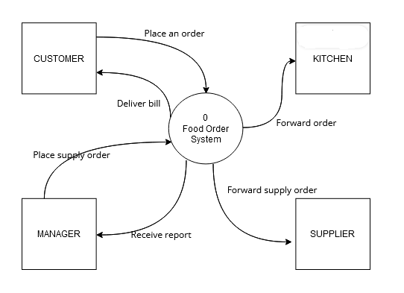
Context Diagram - Example (Food Order System)

Slide 17
Context Diagram - Example
ADMIN
0
UIU Management System
STUDENT
RESEARCHERS
TEACHERS

Slide 18
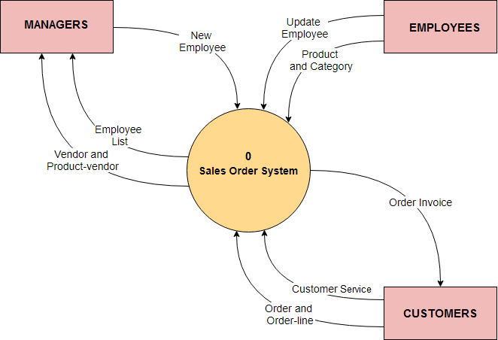
Context Diagram - Example

Slide 19
Data Flow Diagram
Data Flow Diagram is a way of representing flow of data between entities and data stores through a process.
DFD provides information about the outputs and inputs of each entity and the process itself.
DFD has no control flow, there are no Decision rules and no Loops

Slide 20
Data Flow Diagram
Components:
Process: any process that changes the data, producing an output.
External Entity: an outside system that sends or receives data, communicating with the system being diagrammed.
Data Store: files or repositories that hold information for later use, such as a database table or a membership form.
Data Flow: the route that data takes between the external entities, processes and data stores.

Slide 21
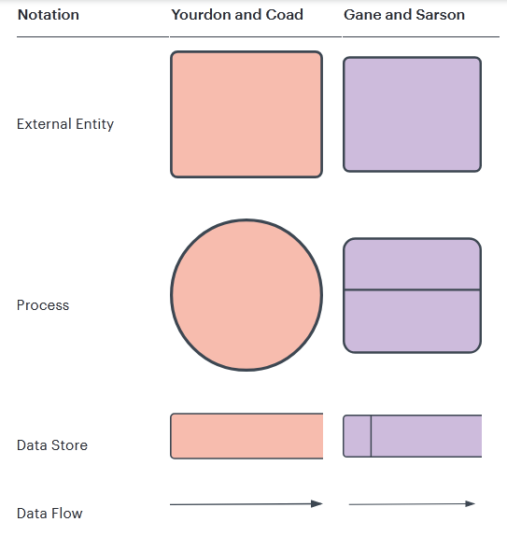
Data Flow Diagram
Notations:

Slide 22
Data Flow Diagram
Rules & Tips:
Each process and sub-process must have name and number; First letter of each word in capital letters
External Entities and Data Stores are all in capital letters
Each process should have at least one input and an output.
Each data store should have at least one data flow in and one data flow out.
Data stored in a system must go through a process.
All processes in a DFD go to another process or a data store.
No connection: DB to DB, DB to EE, EE to EE
DFD starts from Top-Left and ends at Bottom-Right

Slide 23
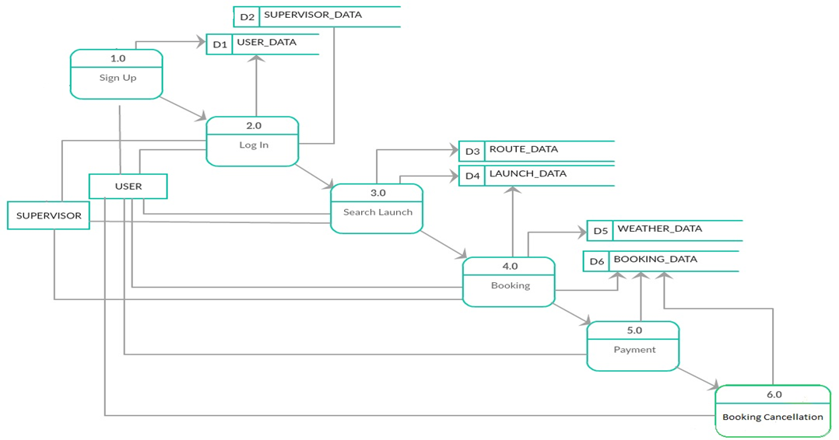
Data Flow Diagram - Example

Slide 24
Data Flow Diagram - Example
A Food Order system is described below:
A Customer can place an order in the Food Order System. As soon as the order is received it is processed and forwarded to the Kitchen. The order is stored in the Order data store and the updated Inventory details is stored in the Inventory data store. The process also delivers a Bill to the Customer.
A Manager can receive Reports through the Generate Reports process, which takes Inventory details and Orders as input from the Inventory and Order data store respectively. He/She can also initiate the Order Inventory process by providing Inventory order. The process forwards the Inventory order to the Supplier and stores the updated Inventory details in the Inventory data store.
Draw a Data Flow Diagram of the Food Order System

Slide 25
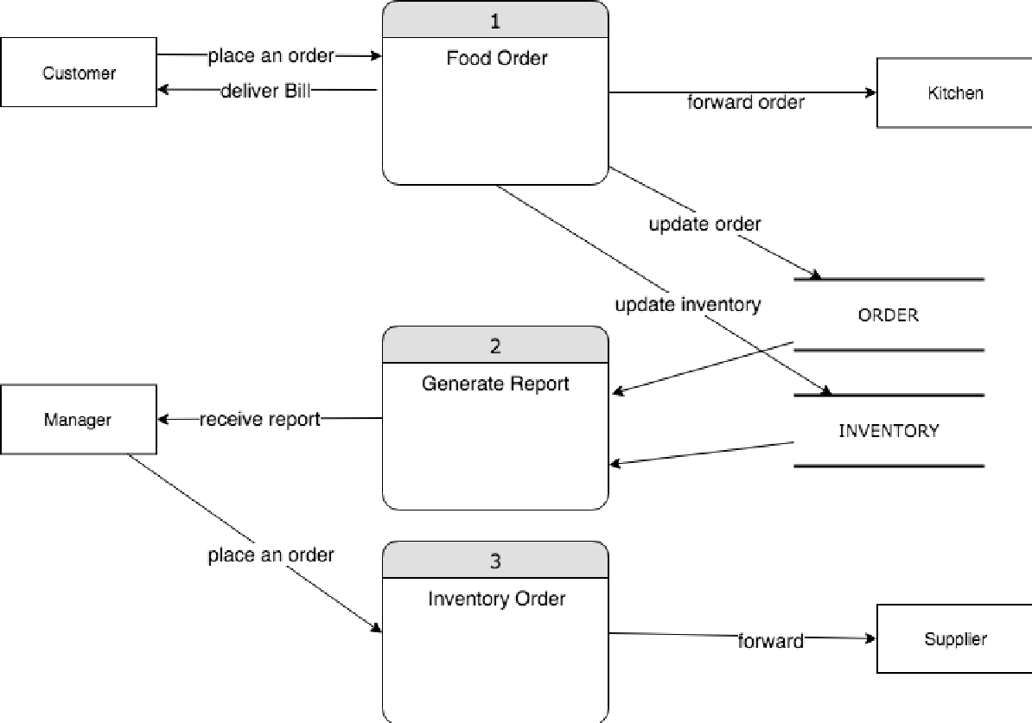
Data Flow Diagram - Example (Food Order System)

Slide 26
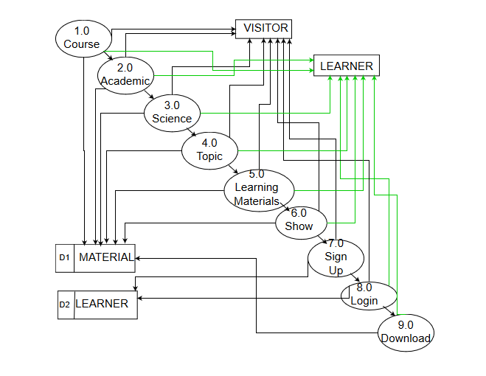
Data Flow Diagram - Example (eLearning System)

Slide 27
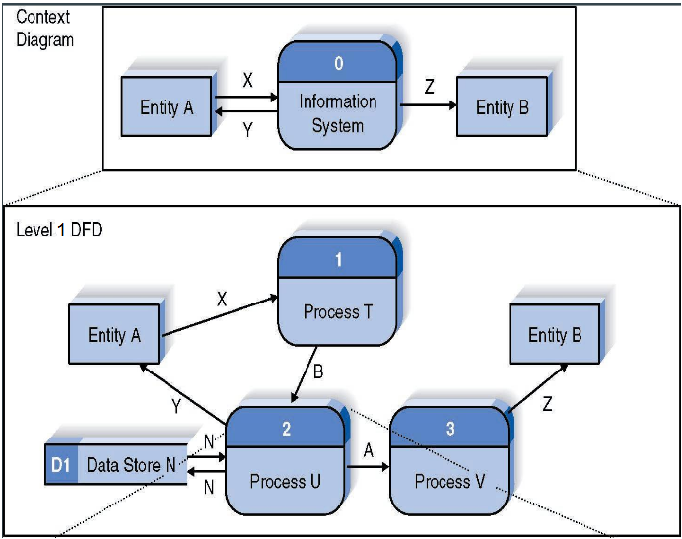
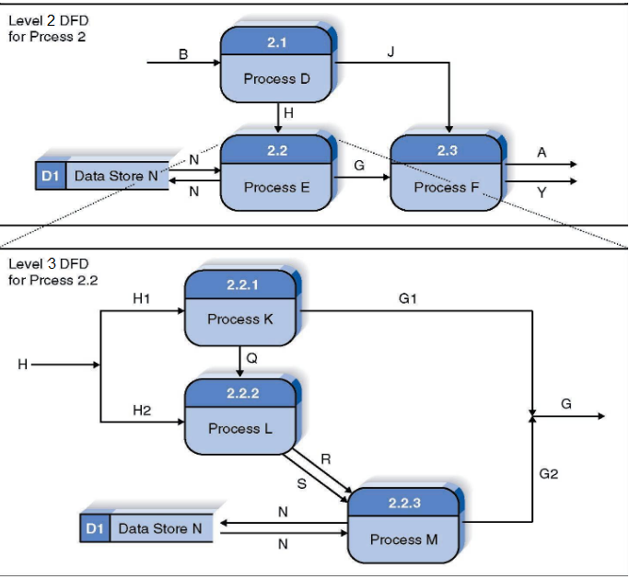
Relationship Among DFD Levels

Slide 28
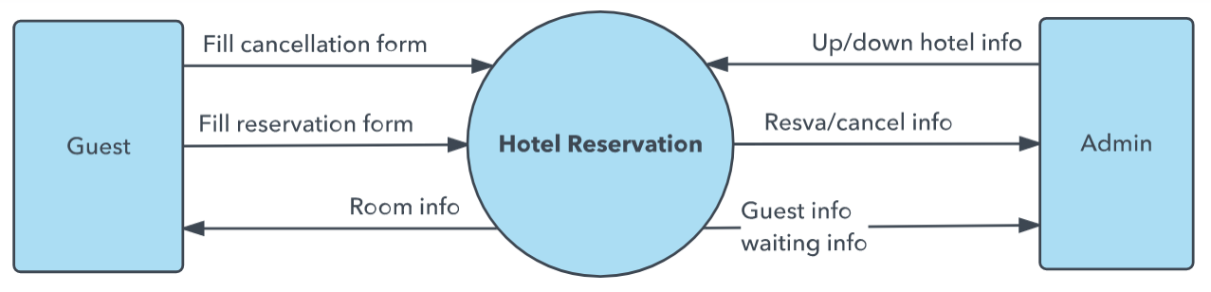
DFD Example - Hotel Reservation System Level 0

Slide 29
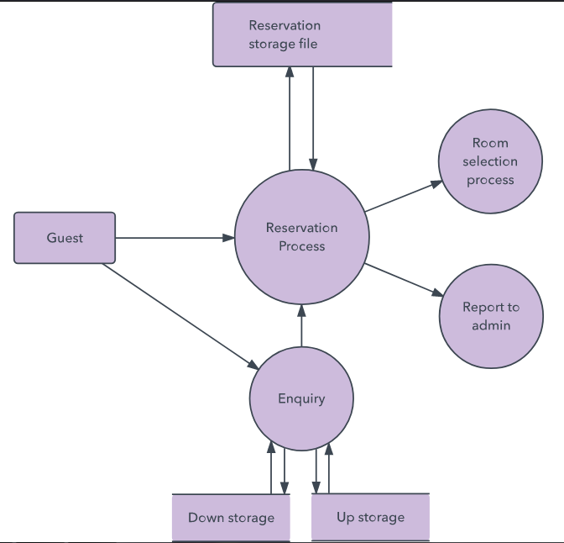
DFD Example - Hotel Reservation System Level 1

Slide 30
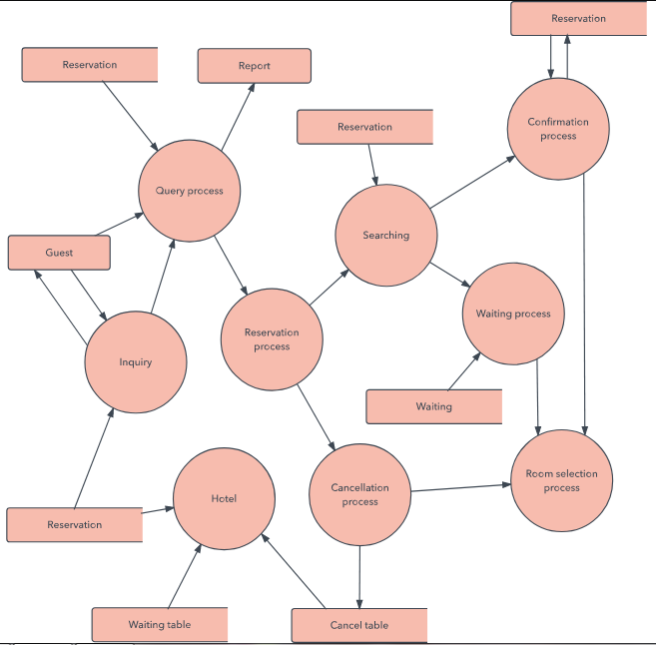
DFD Example - Hotel Reservation System Level 2

Slide 31
Use Case Diagram
Represents the interaction between actors (users or external entities) and a system to accomplish specific goals.
It provides a high-level view of the system’s functionality by illustrating the various ways users can interact with it.
Emphasis on what a system does rather than how.
Closely connected to scenarios (a scenario is an example of what happens when someone interacts with the system)

Slide 32
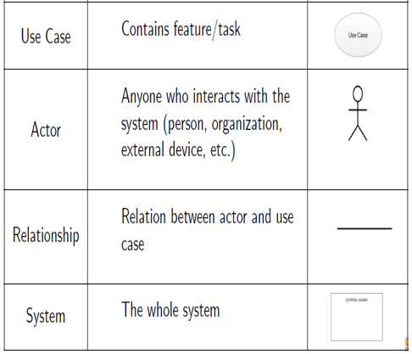
Use Case Diagram
Components & Notations : —

Slide 33
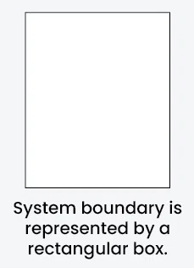
Use Case Diagram
Components & Notations
The system boundary is a visual representation of the scope or limits of the system you are modeling. It defines what is inside the system and what is outside.

Slide 34
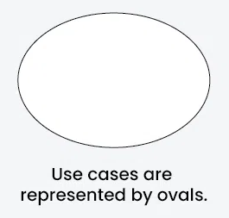
Use Case Diagram
Components & Notations
Use Cases are like scenes in the play. They represent specific things your system can do.

Slide 35
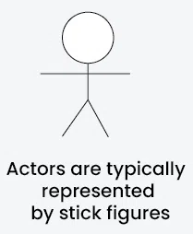
Use Case Diagram
Components & Notations
Actors are external entities that interact with the system. These can include users, other systems, or hardware devices. In the context of a Use Case Diagram, actors initiate use cases and receive the outcomes.

Slide 36
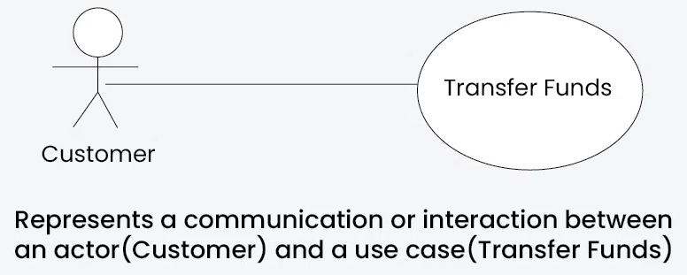
Use Case Diagram
Relationships & Notations
The Association Relationship represents a communication or interaction between an actor and a use case. It is depicted by a line connecting the actor to the use case.

Slide 37
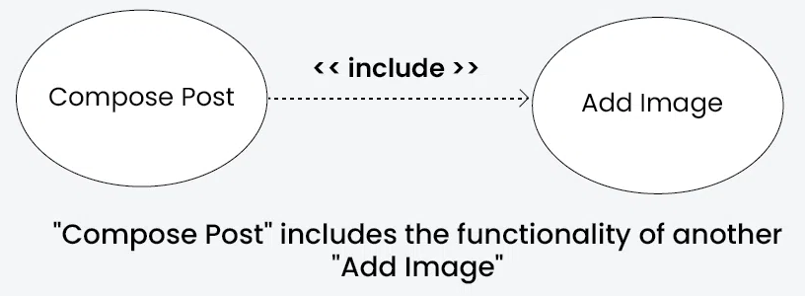
Use Case Diagram
Relationships & Notations
The Include Relationship indicates that a use case includes the functionality of another use case. It is denoted by a dashed arrow pointing from the including use case to the included use case.

Slide 38
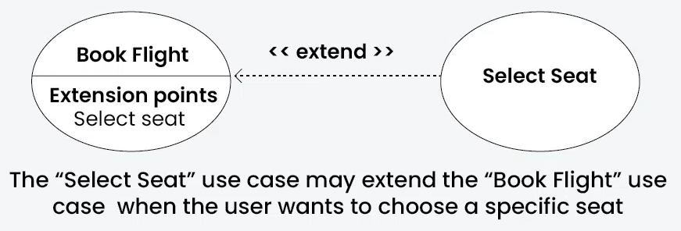
Use Case Diagram
Relationships & Notations
The Extend Relationship illustrates that a use case can be extended by another use case under specific conditions. It is represented by a dashed arrow with the keyword “extend.”

Slide 39
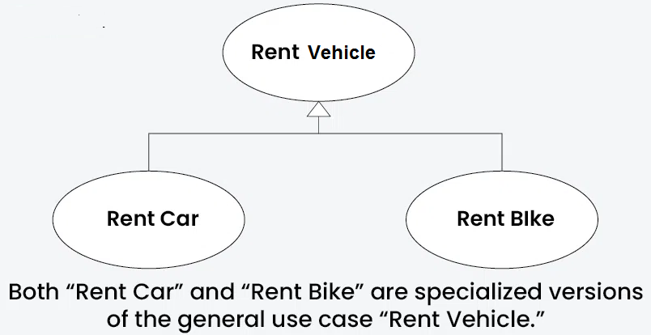
Use Case Diagram
Relationships & Notations
The Generalization Relationship establishes an “is-a” connection between two use cases, indicating that one use case is a specialized version of another. It is represented by an arrow pointing from the specialized use case to the general use case.

Slide 40
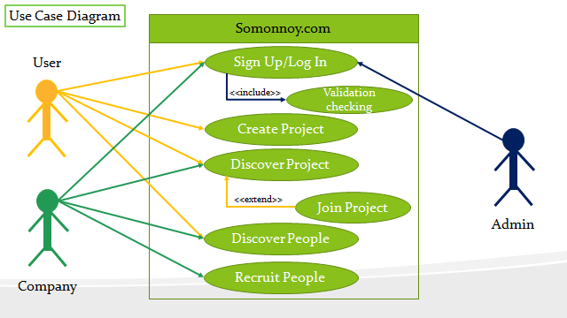
Use Case Diagram - Example

Slide 41
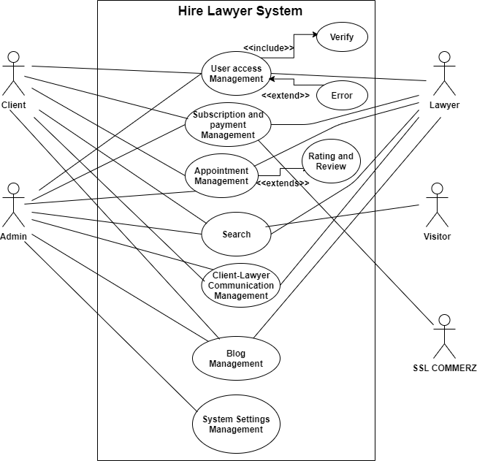
Use Case Diagram - Example

Slide 42
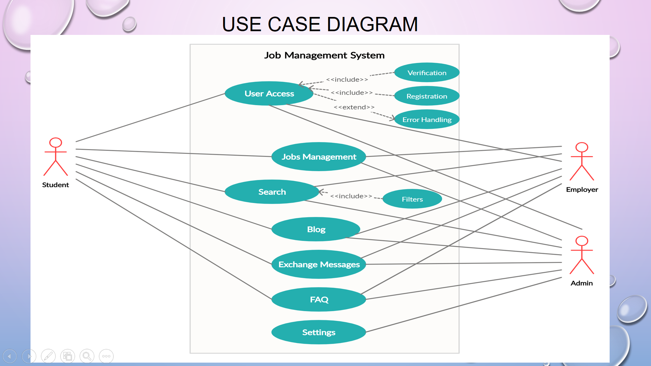
Use Case Diagram - Example

Slide 43
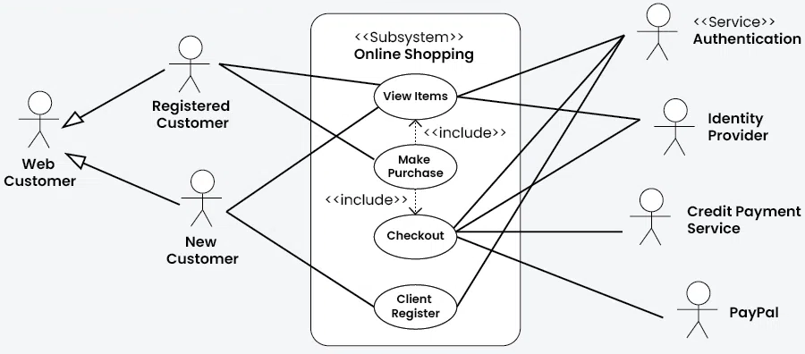
Use Case Diagram - Example

Slide 44
Use Case Descriptive Forms
A Use Case Descriptive Form is used to describe a single Use Case. Thus, EVERY Use Case should have its Descriptive Form.
Components:
Use case number and name
Description
Stakeholders and Interests
Primary Actor
Pre-conditions
Success Scenario
Alternative Scenario
Post-conditions

Slide 45
Description | Brief description that states the purpose of the use case in a couple of sentences
Actors | Which actors interact with the use case
Primary Actor | For which actor the use case is the most significant
Pre-conditions | What has to occur before the use case starts
Main Flow of Events / Success Scenario | The normal sequence of events When everything goes smoothly - No complications Written as a list in normal language.
Alternative Flow of Events | Exceptions to the normal flow. These are alternative paths to deal with errors. different circumstances, etc.
Post-conditions | What occurs after the use case ends

Slide 46
Use Case Descriptive Form - Example
Customer
Sell Item
Cashier

Slide 47
UC 01: Sell Item – Descriptive Form
Description : Customer pays the cashier in exchange for an item.
Stakeholders and Interests :
Cashier : Wants accurate, fast entry and no payment errors.
Customer : Wants purchase and fast service with minimal effort. Wants receipt if future return of product is necessary.
Company (owner) : Wants to accurately record transactions and satisfy customer interests.
Government Tax Agencies : Want to collect tax from every sale.
Primary Actor : Cashier
Pre-conditions : Cashier is identified and authenticated.

Slide 48
UC 01: Sell Item – Descriptive Form
Success Scenario :
1. Customer arrives at counter with goods to purchase.
2. Cashier starts a new sale.
3. Cashier enters item identifier.
4. System records sale item and presents item description, price and running total
Cashier repeats steps 3-4 until indicated done
5. System presents total with tax calculated.
6. Cashier tells customer the total and asks for payment.
7. Customer pays and system handles payment.
8. System presents receipt.
9. Customer leaves with receipt and goods.

Slide 49
UC 01: Sell Item – Descriptive Form
Alternative Scenario :
*a At any time, System can fail:
1. Cashier restarts System, logs in and request recovery of prior state.
2. System re-constructs prior state.
3. Invalid identifier (scanner does not work):
1. Signals system error and rejects entry.
2. Manual Entry given
3-6 a) Customer asks cashier to remove an item
i. Cashier enters item identifier for removal of sale.
ii. System displays updated running total.
3-6 b) Customer tells cashier to cancel sale
i. Cashier cancels sale on System.

Slide 50
UC 01: Sell Item – Descriptive Form
Post-conditions :
Sale is saved. Tax is correctly calculated. Accounting and inventory updated. Receipt is generated.

Slide 51
Activity Diagram
Shows how activities are coordinated to achieve a single event
Similar to flowchart
Suitable for modelling use cases to represent business workflows

Slide 52
Activity Diagram
Components & Notations
Action is a task to be performed
Control Flow shows the sequence of execution
Initial Node portrays the beginning of a set of actions or activities
Activity Final Node stops all control flows in an activity (or action)
Action

Slide 53




Activity Diagram
Components & Notations
Decision Node represents a test condition to ensure that the control flow only goes down one path
Merge Node brings back together different decision paths that were created using a decision-node.
Fork Node splits behavior into a set of parallel or concurrent flows of activities (or actions)
Join Node brings back together a set of parallel or concurrent flows of activities (or actions).

Slide 54
Activity Diagram - Example (Student Enrolment)
An applicant wants to enroll in the university.
The applicant hands a filled out copy of Enrollment Form.
The registrar inspects the forms.
The registrar determines that the forms have been filled out properly.
The registrar informs student to attend in university overview presentation.
The registrar helps the student to enroll in seminars
The registrar asks the student to pay for the initial tuition.

Slide 55
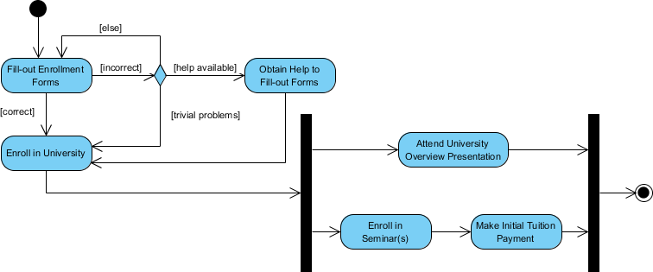
Activity Diagram - Example (Student Enrolment)

Slide 56
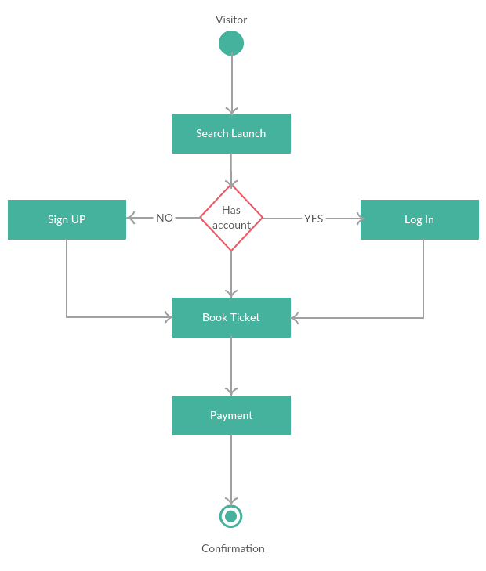
Activity Diagram - Example (Typical User/Visitor)

Slide 57
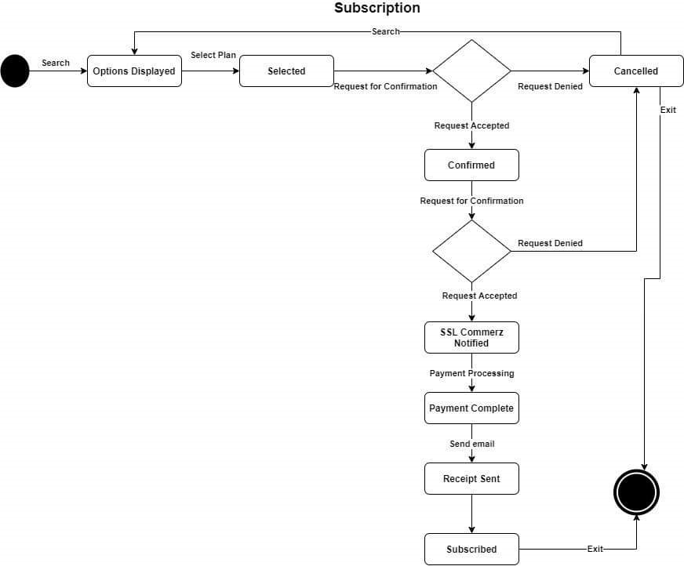
Activity Diagram - Example (Payment)

Slide 58
Swimlane Diagram
A way to group activities performed by the same actor on an activity diagram
Visually distinguishes job sharing or responsibilities among different stakeholders for different activities or processes
May be arranged either horizontally or vertically

Slide 59
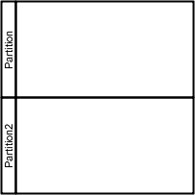
Swimlane Diagram
Components & Notations
All same as activity diagram except the swimlanes and partitions
Swimlane and Partition groups activities performed by the same actor

Slide 60
Swimlane Diagram - Example

Slide 61
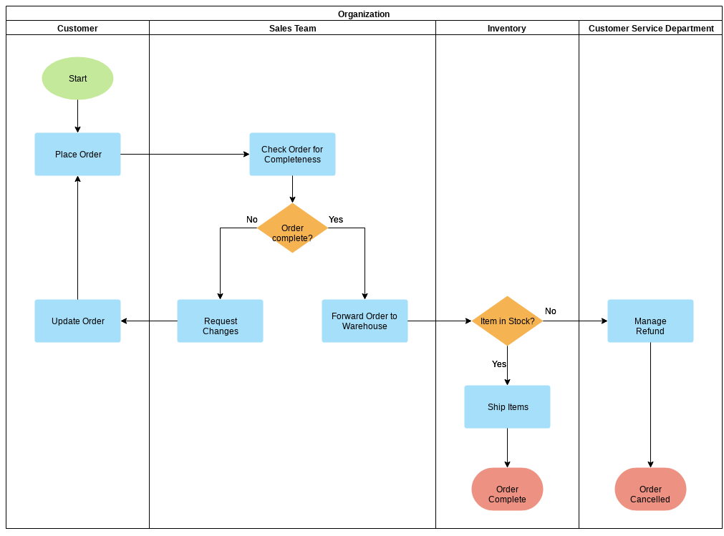
Swimlane Diagram - Example

Slide 62
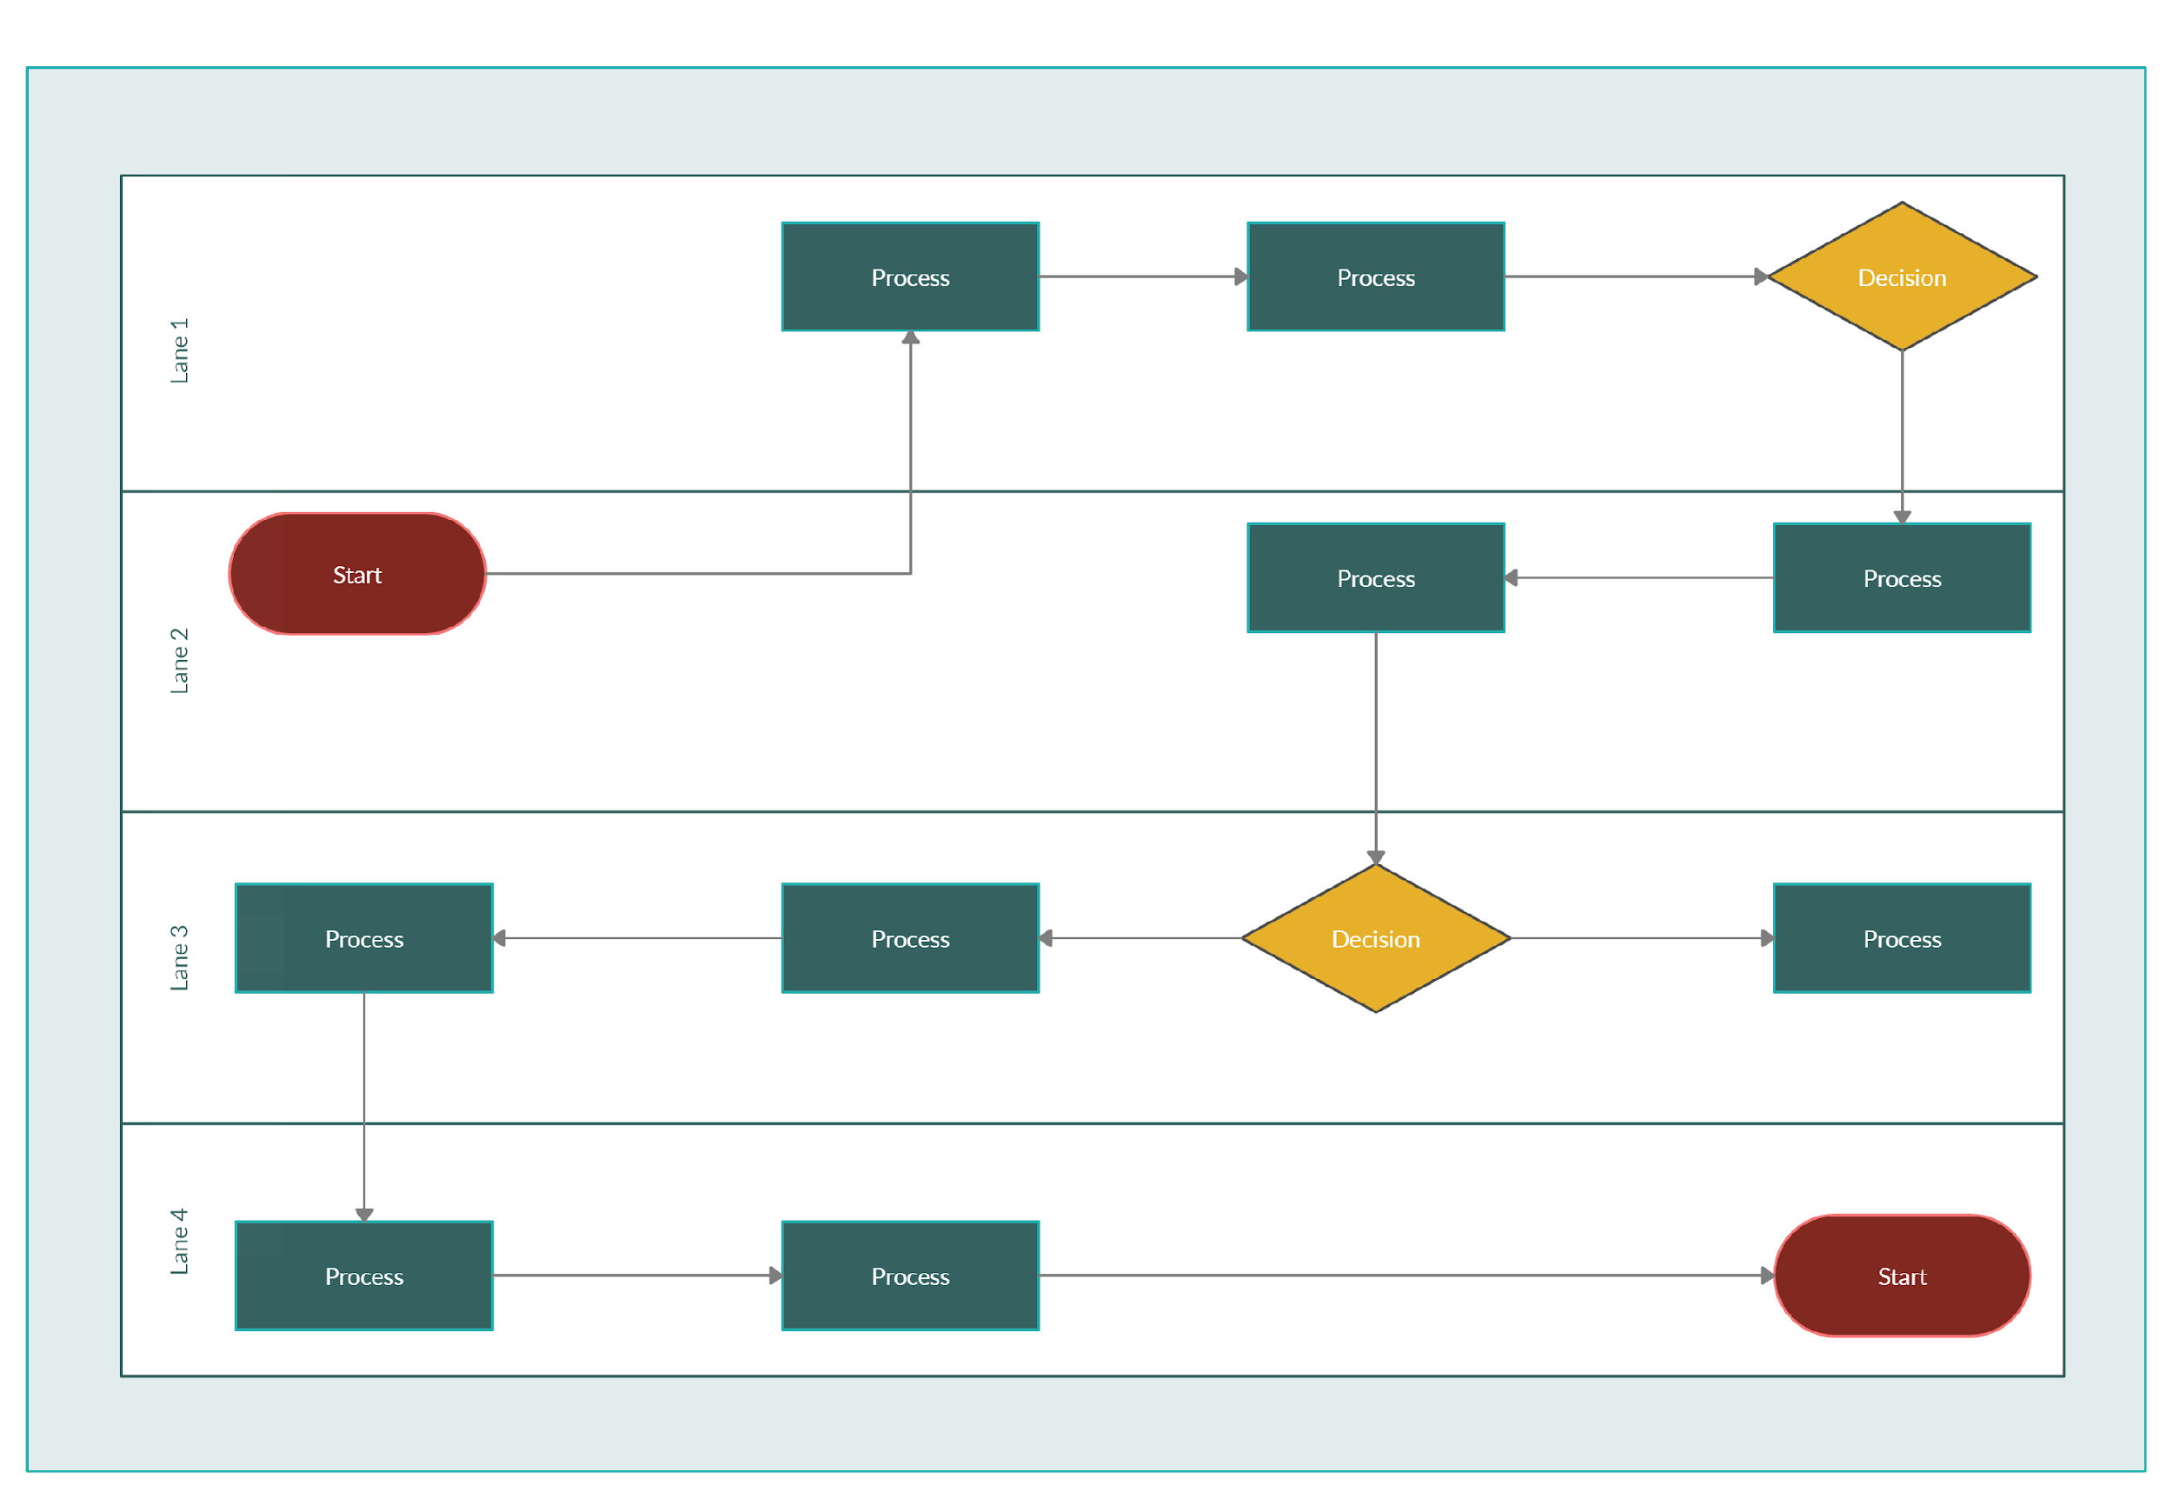
Swimlane Diagram - Example

Slide 63
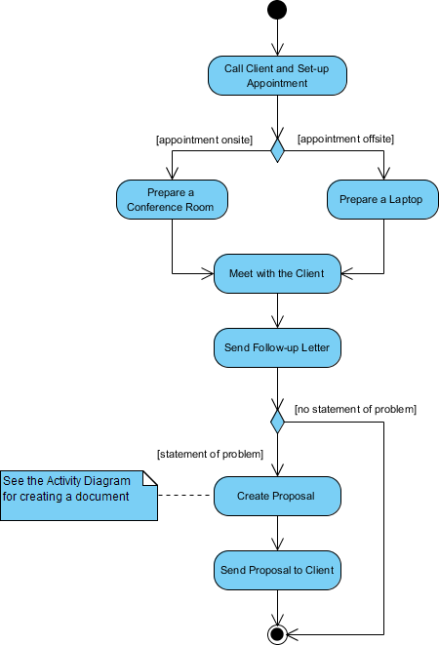
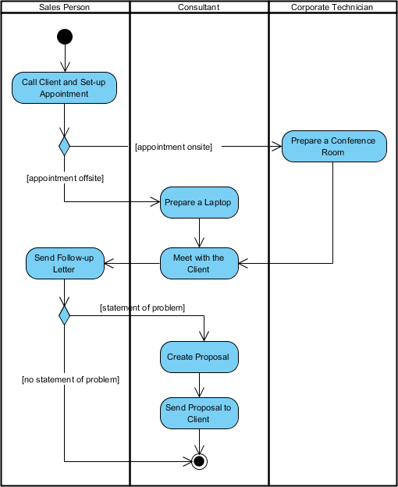
Activity & Swimlane Diagram - Example (business process for meeting a new client)

Slide 64
https://www.geeksforgeeks.org/what-is-system-design-learn-system-design/
https://www.lucidchart.com/pages/data-flow-diagram
https://www.geeksforgeeks.org/unified-modeling-language-uml-introduction/
https://uwaterloo.ca/ist-project-management-office/tools-and-templates/tools/context-diagram
https://online.visual-paradigm.com/knowledge/system-context-diagram/what-is-system-context-diagram/
https://www.geeksforgeeks.org/use-case-diagram/
https://edshare.gcu.ac.uk/3333/2/index.html
https://www.visual-paradigm.com/guide/uml-unified-modeling-language/what-is-activity-diagram/
References

